Slide 1
TRAFFIC
LIGHTS
CAALP PBL

Slide 2
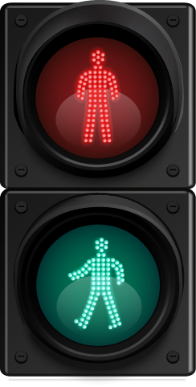
INTRODUCTION
TRAFFIC LIGHT
The objective of our project is to simulate a traffic light system using the 8086 microprocessor. Users can select from three states, each representing a traffic light color: Red, Yellow, and Green. Upon selection, the corresponding color is displayed. This project demonstrates the practical application of assembly language programming with the 8086 microprocessor.

Slide 3
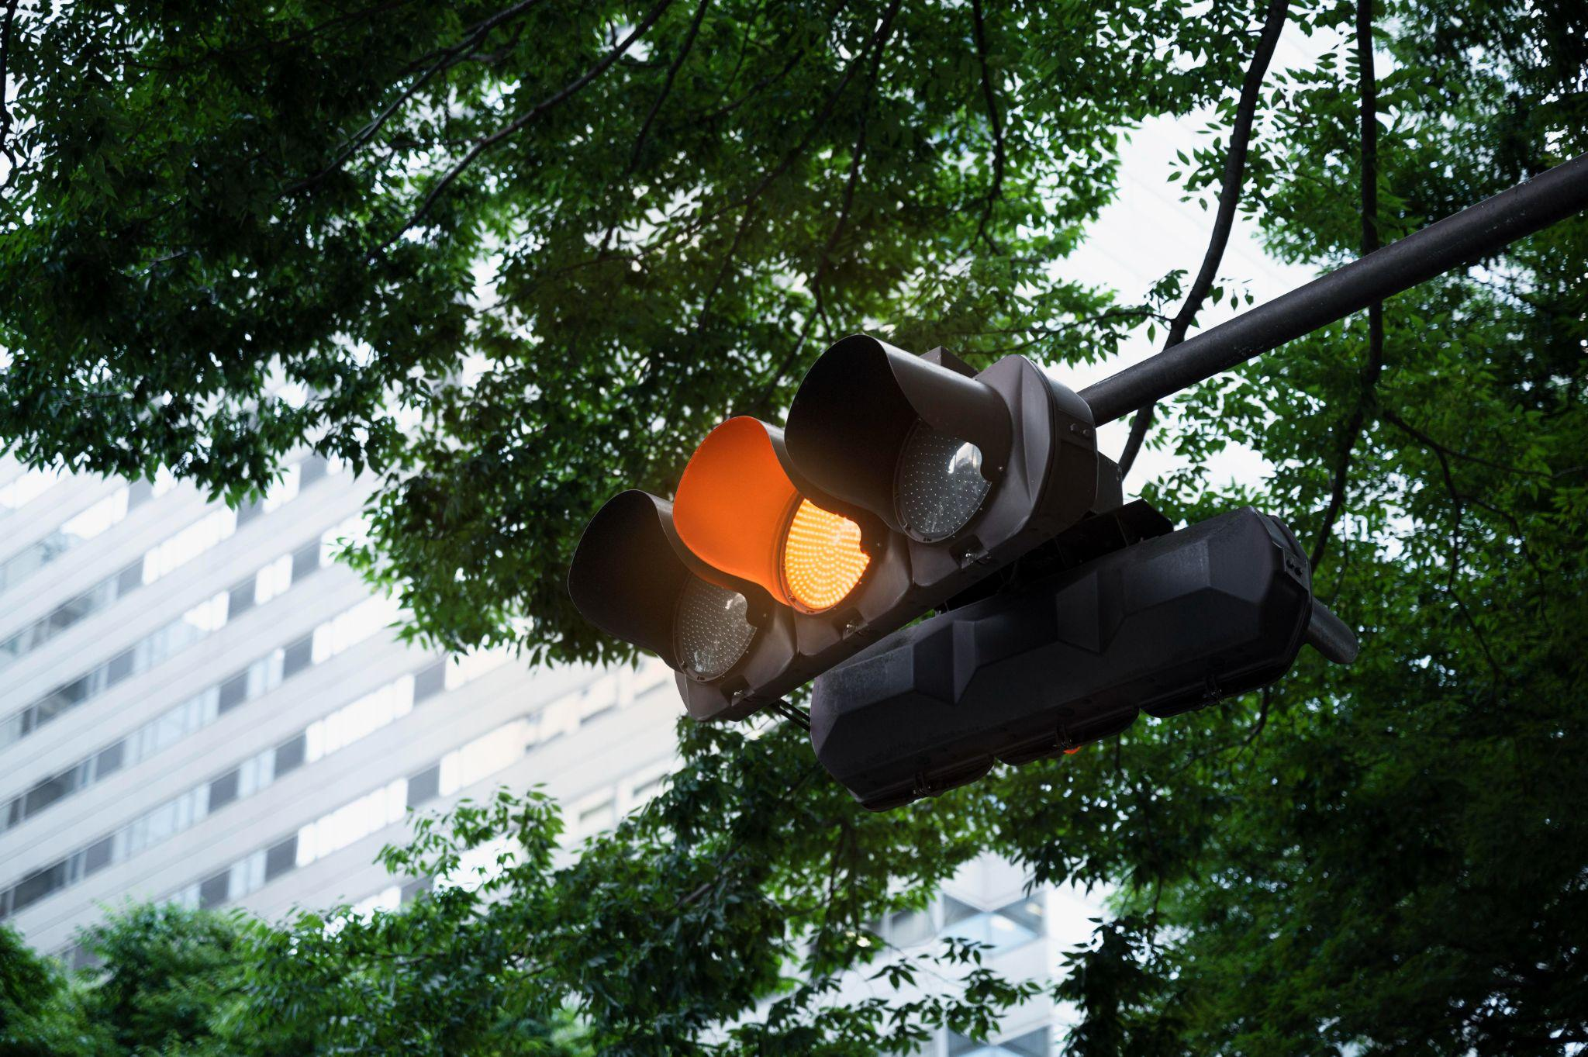
Importance of 8086 microprocessor
Simple Architecture
Rich Instruction Set
Effective I/O Handling
Educational Accessibility

Slide 4
CODE
ASSUME CS:CODE, DS:DATA
DATA SEGMENT
PROMPT DB 'Choose state (1-GREEN, 2-YELLOW, 3-RED): $'
GREEN DB 'GREEN', 0AH, 0DH, '$’ ; Message for green light
YELLOW DB 'YELLOW', 0AH, 0DH, '$’ ; Message for yellow light
RED DB 'RED', 0AH, 0DH, '$' ; Message for red light
GO_MESSAGE DB 'GO', 0AH, 0DH, '$' ; Message for GO
WAIT_MESSAGE DB 'WAIT', 0AH, 0DH, '$' ; Message for WAIT
STOP_MESSAGE DB 'STOP', 0AH, 0DH, '$' ; Message for STOP
COLOR_SELECTED DB '0' ; Variable to store user choice
CURRENT_COLOR DB '0' ; Variable to store current color
DATA ENDS

Slide 5
CODE SEGMENT
START:
MOV AX, DATA ; Load the data segment address into AX
MOV DS, AX ; Set the data segment register to point to the data segment
CALL CLEAR_SCREEN ; Clear the screen initially
MAIN_LOOP:
CALL DISPLAY_PROMPT ; Display the prompt message
CALL GET_USER_INPUT ; Get the user input
CMP AL, '1'
JE SET_GREEN
CMP AL, '2'
JE SET_YELLOW
CMP AL, '3'
JE SET_RED
JMP MAIN_LOOP ; If invalid input, loop back

Slide 6
SET_GREEN:
MOV BYTE PTR COLOR_SELECTED, '1'
CMP BYTE PTR CURRENT_COLOR, '1'
JE SKIP_COLOR_CHANGE ; If already green, skip changing color
CALL SET_BACKGROUND_GREEN
MOV BYTE PTR CURRENT_COLOR, '1'
JMP DISPLAY_MESSAGE
SET_YELLOW:
MOV BYTE PTR COLOR_SELECTED, '2'
CMP BYTE PTR CURRENT_COLOR, '2'
JE SKIP_COLOR_CHANGE ; If already yellow, skip changing color
CALL SET_BACKGROUND_YELLOW
MOV BYTE PTR CURRENT_COLOR, '2'
JMP DISPLAY_MESSAGE
SET_RED:
MOV BYTE PTR COLOR_SELECTED, '3'
CMP BYTE PTR CURRENT_COLOR, '3'
JE SKIP_COLOR_CHANGE ; If already red, skip changing color
CALL SET_BACKGROUND_RED
MOV BYTE PTR CURRENT_COLOR, '3'
JMP DISPLAY_MESSAGE

Slide 7
SKIP_COLOR_CHANGE:
JMP MAIN_LOOP ; Skip displaying message if color didn't change
DISPLAY_MESSAGE:
CALL PRINT_MESSAGE ; Print the selected color message
JMP MAIN_LOOP ; Jump back to the main loop to repeat
DISPLAY_PROMPT PROC
MOV DX, OFFSET PROMPT
MOV AH, 09H
INT 21H
RET
DISPLAY_PROMPT ENDP
GET_USER_INPUT PROC
MOV AH, 01H
INT 21H
RET
GET_USER_INPUT ENDP

Slide 8
PRINT_MESSAGE PROC
MOV AH, 09H
CMP COLOR_SELECTED, '1'
JE PRINT_GREEN
CMP COLOR_SELECTED, '2'
JE PRINT_YELLOW
CMP COLOR_SELECTED, '3'
JE PRINT_RED
RET
PRINT_GREEN:
MOV DX, OFFSET GREEN
INT 21H
MOV DX, OFFSET GO_MESSAGE
INT 21H
RET
PRINT_YELLOW:
MOV DX, OFFSET YELLOW
INT 21H
MOV DX, OFFSET WAIT_MESSAGE
INT 21H
RET
PRINT_RED:
MOV DX, OFFSET RED
INT 21H
MOV DX, OFFSET STOP_MESSAGE
INT 21H
RET
PRINT_MESSAGE ENDP

Slide 9
SET_BACKGROUND_GREEN PROC
MOV AX, 0B800H ; Video memory segment
MOV ES, AX
XOR DI, DI ; Start at the beginning of video memory
MOV CX, 4000 ; Total words in video memory (80 columns * 25 rows)
MOV AL, ' ' ; Space character
MOV AH, 2Eh ; Attribute for green background ('2' for green)
REP STOSW ; Store AX (character and attribute) in ES:DI and increment DI
RET
SET_BACKGROUND_GREEN ENDP
SET_BACKGROUND_YELLOW PROC
MOV AX, 0B800H ; Video memory segment
MOV ES, AX
XOR DI, DI ; Start at the beginning of video memory
MOV CX, 4000 ; Total words in video memory (80 columns * 25 rows)
MOV AL, ' ' ; Space character
MOV AH, 6Eh ; Attribute for yellow background ('6' for yellow)
REP STOSW ; Store AX (character and attribute) in ES:DI and increment DI
RET
SET_BACKGROUND_YELLOW ENDP

Slide 10
SET_BACKGROUND_RED PROC
MOV AX, 0B800H ; Video memory segment
MOV ES, AX
XOR DI, DI ; Start at the beginning of video memory
MOV CX, 4000 ; Total words in video memory (80 columns * 25 rows)
MOV AL, ' ' ; Space character
MOV AH, 4Eh ; Attribute for red background ('4' for red)
REP STOSW ; Store AX (character and attribute) in ES:DI and increment DI
RET
SET_BACKGROUND_RED ENDP
CLEAR_SCREEN PROC
MOV AH, 06h ; Function to scroll up window (clear screen)
MOV AL, 00h ; Clear entire screen
MOV BH, 07h ; Attribute for blank (black background, white text)
MOV CX, 0000h ; Top-left corner of the window
MOV DX, 184Fh ; Bottom-right corner of the window (80x25 text mode)
INT 10h ; BIOS video interrupt
RET
CLEAR_SCREEN ENDP
CODE ENDS
END START

Slide 11
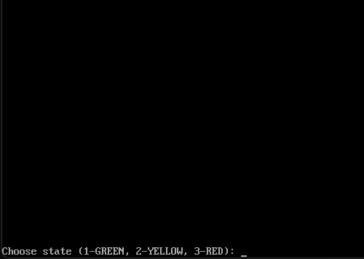
OUTPUT

Slide 12
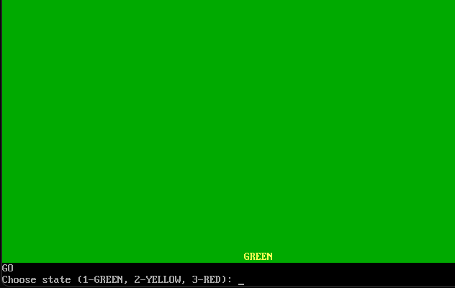

Slide 13
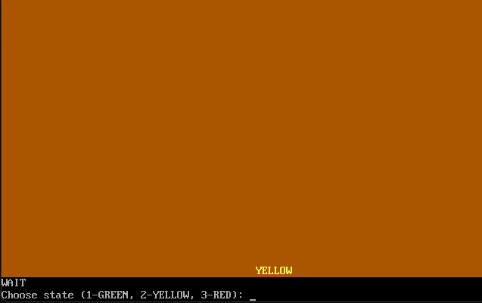

Slide 14
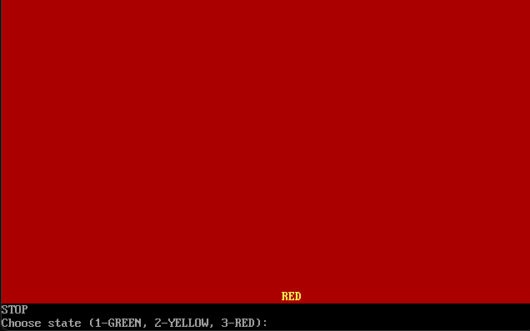

Slide 15
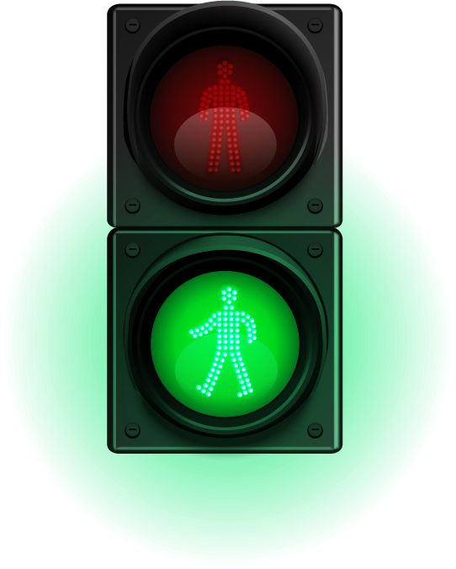
How can this be an interface for other programming languages?
TRAFFIC LIGHT
I/O Interaction
API Design
Shared Memory or Files
Networking Protocols
Integration with GUIs

Slide 16

SYSTEM REQUIREMENTS
Software Requirements
Hardware Requirements
Processor
Memory (RAM)
Input Devices (e.g., Keyboard)
DOSBox
Assembler
Text Editor
Documentation

Slide 17
CONCLUSION
TRAFFIC LIGHT
Our project simulated a traffic light system using the 8086 microprocessor and assembly language in DOSBox on Windows 11. This experience deepened our understanding of microprocessor architecture and assembly programming. Future improvements may include integrating advanced traffic algorithms and enhancing user interaction. This project underscores the educational value of hands-on assembly language programming and system simulation, offering insights into real-time applications and software development on legacy platforms.

Slide 18

THANK YOU
TRAFFIC LIGHT

